Slide 1

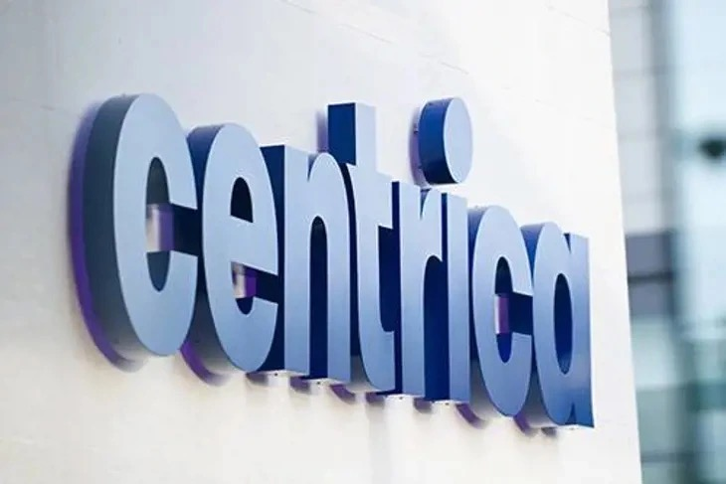
MY JOURNEY at

Slide 2
A WILD 9 WEEKS - WHAT DID I START WITH?
DTS team – SRE
Managed by – Chris Livermore

Slide 3
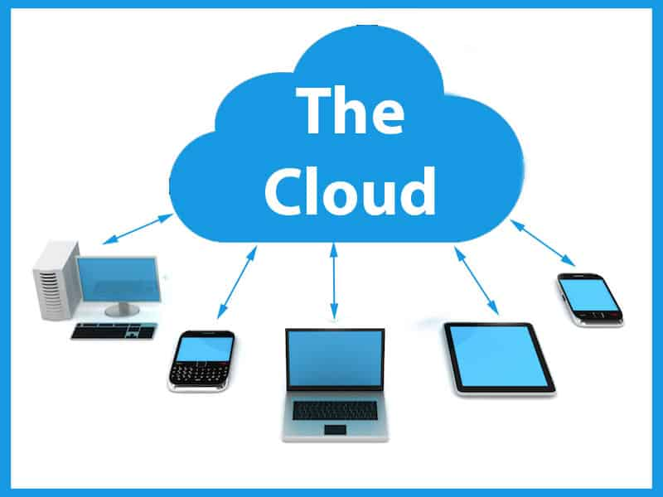
What is cloud computing?
‘It is somebody else’s computer’
On-demand availability of computing resources over the internet.
It is like renting an apartment instead of buying a house.
Key Features:
Scalability
Pay-as-you-go pricing
High availability
Cloud Providers: AWS, Azure, GCP
Notes:
Analogy: The cloud is like renting an apartment instead of buying a house.
When you rent an apartment (cloud), the landlord (cloud provider) takes care of most things (hardware, networking, etc.), and you only worry about what’s inside your apartment (your application).
In business: Companies use the cloud to avoid upfront hardware costs and get scalable, on-demand computing power without worrying about physical infrastructure.

Slide 4

Introduction to AWS
What is AWS? Amazon Web Services – leading cloud provider
Core Services Used:
EC2 (Virtual Servers)
VPC (Networking)
S3 (Storage)
IAM (Access Control)
CloudWatch (Monitoring)
Notes:
Analogy: AWS is like a giant shopping mall of IT services.
Just like you can walk into a mall and find everything from a bakery to a furniture store, AWS gives you pre-built services for:
Computing (EC2)
Storage (S3)
Databases (RDS)
Monitoring (CloudWatch)
and hundreds more.

Slide 5
Built a Minecraft server
Without using AWS console
Only with terraform (infrastructure-as-code)
Notes:
Analogy: Hosting a Minecraft server is like opening your own online gaming café.
Using cloud services like AWS EC2, you can scale up your server for more players or turn it off when not in use.
In business (parallel): Just like hosting a Minecraft server, companies host their own custom applications in the cloud, managing their own “rules” (code, security, performance) while using the cloud for flexibility and reach.

Slide 6
Terraform – Infrastructure as Code
What is Terraform? Tool for automating infrastructure provisioning
Version control of infrastructure
Reusability
Consistency across environments

Slide 7
Why do it all in terraform?
scalability(e.g. getting 15 servers to run is much easier when you code it)
debugging code is way easier than debugging on console
only setup in IaC takes time, once it’s done that code is ready to be used multiple times and runtime is fast.
Notes:
Normally, if you want to set up a server or some cloud resources, you might have to click around in a web interface or run lots of commands.
It can also update or delete resources when you change your instructions.

Slide 8
Built a cloudwatch alarm
What is CloudWatch?
AWS service to monitor resources and applications
What I did:
Set up a CloudWatch Alarm
Triggers an alert if more than 5 codebuilds fail within 5 minutes
Benefits:
Proactive monitoring
Cost control
Uptime reliability
Notes:
Analogy: CloudWatch alarms are like security cameras and smoke detectors in your server room.
They monitor your cloud resources (CPU usage, memory, disk, traffic, etc.)
If something goes wrong (CPU > 90%, server down), they can alert you, or even trigger automatic actions (restart a server, scale up resources).

Slide 9
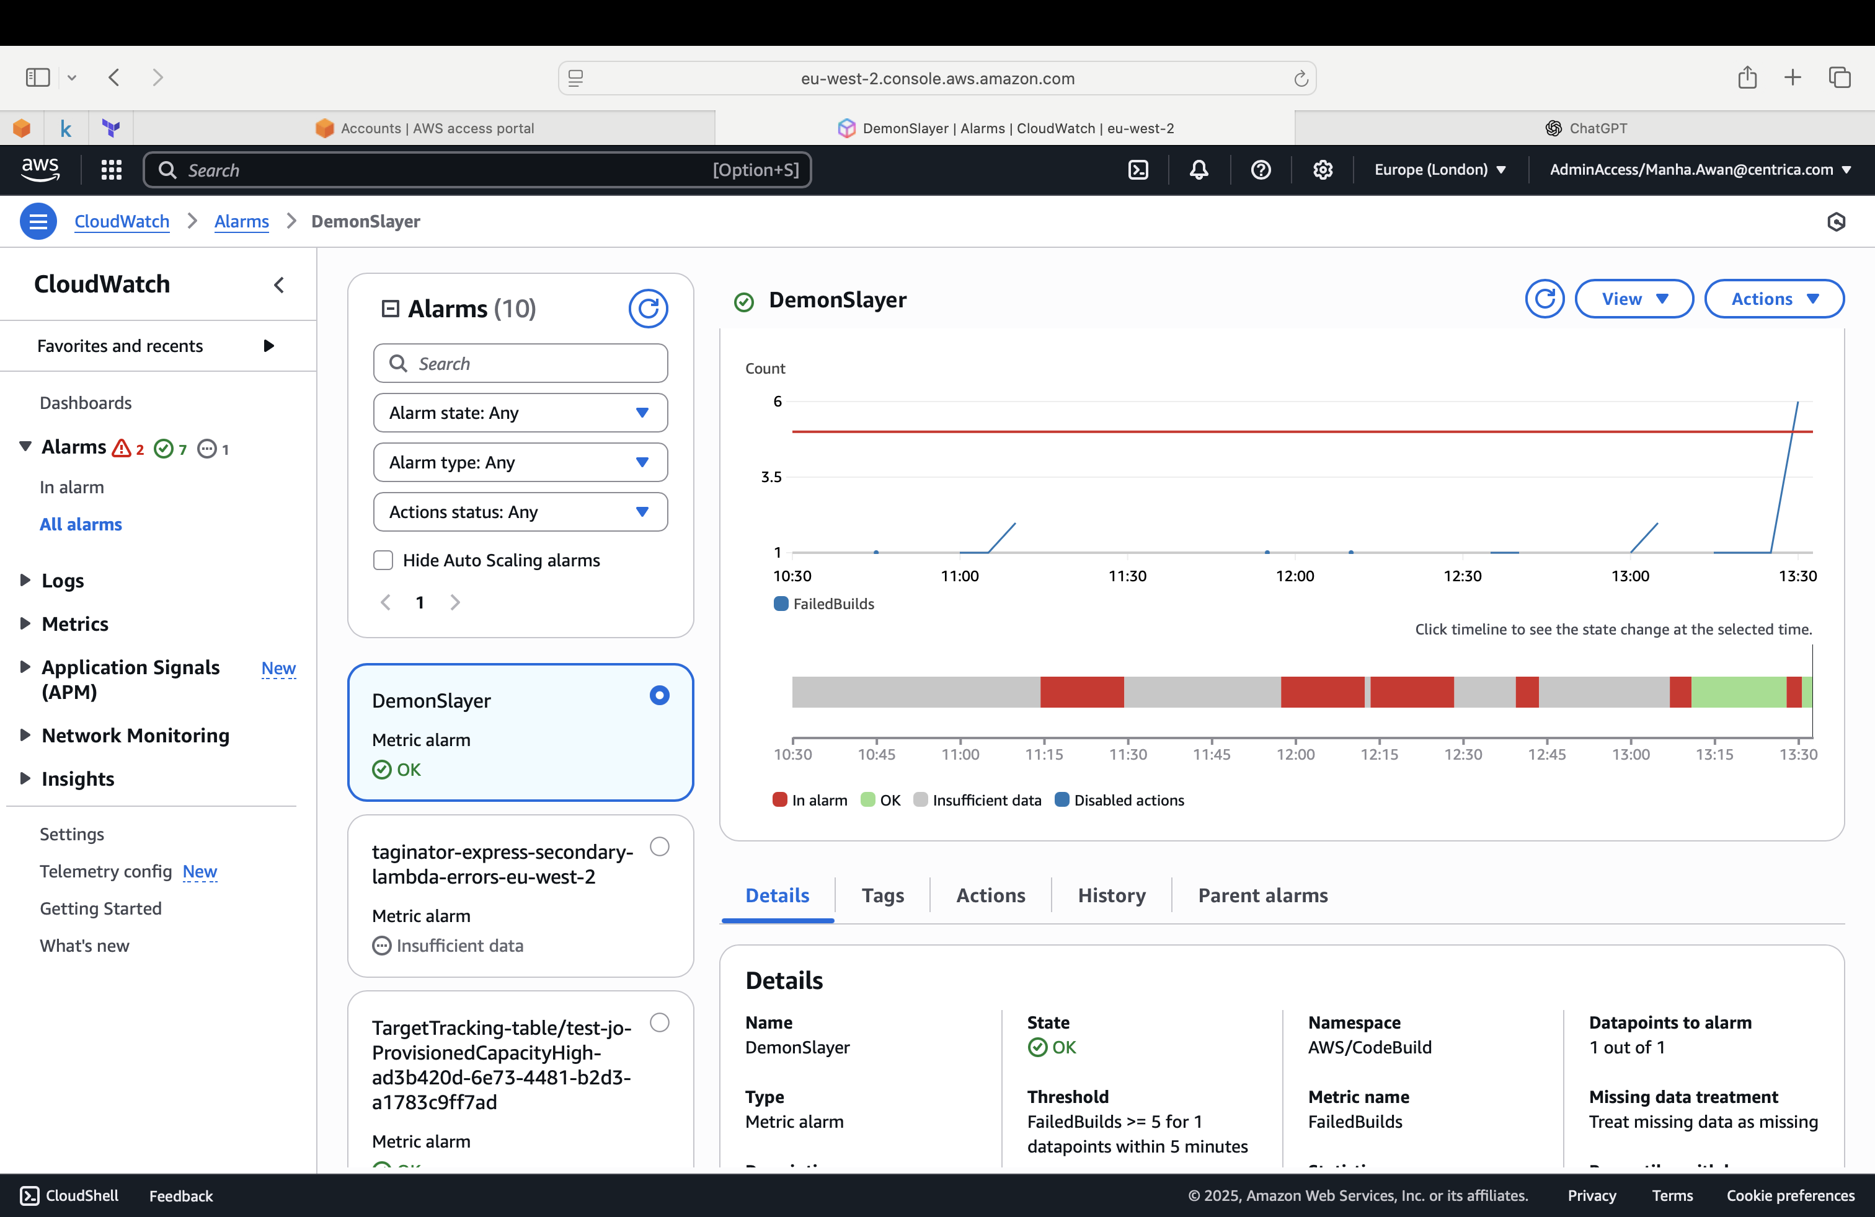
Shows 5 builds have gone over threshold triggering alarm
Will say ‘in-alarm’ when alarm set off

Slide 10

Side projects? Forecasting with machine learning models

Slide 11
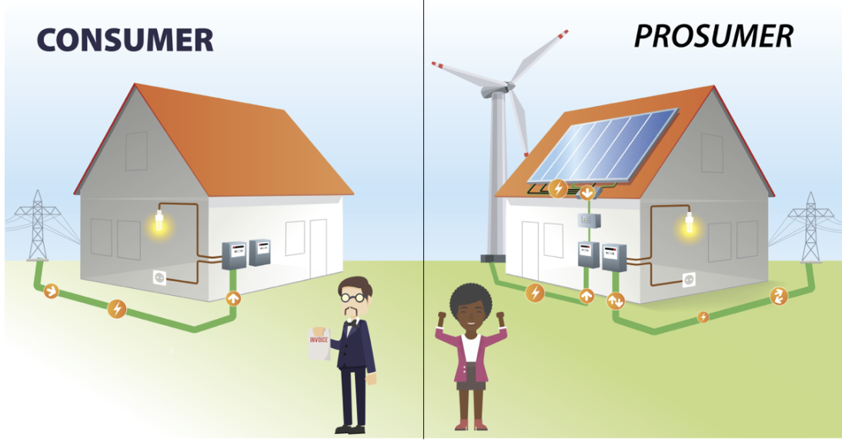
Context of dataset – Kaggle
Create an energy prediction model of prosumers to reduce energy imbalance costs
Prosumers produce and consume energy
This dataset is on Estonian energy customers who have installed solar panels which makes them prosumers
If solved, it would reduce the imbalance costs, improve the reliability of the grid, and make the integration of prosumers into the energy system more efficient and sustainable.

Slide 12
Data science project pipeline

Slide 13
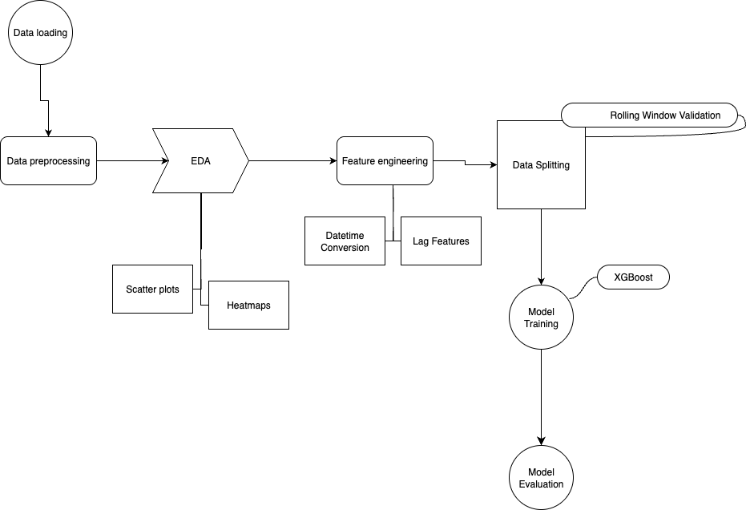

Slide 14

Data loading, merging and preprocessing
Cleaning and organising the ingredients before cooking
Downloading the data, making sure only the consumption data is used, and all four files are merged correctly

Slide 15

Feature engineering- what in the world is that?
Like adding spices to the dish –
We add lag and rolling average features, plus weather forecasts, which act like external flavours influencing consumption
Notes:
Lag features are past values of a data point used to help predict future values (like looking at yesterday’s sales to guess today’s sales).
Rolling features are averages we calculate to smooth out fluctuations so we can reveal trends

Slide 16


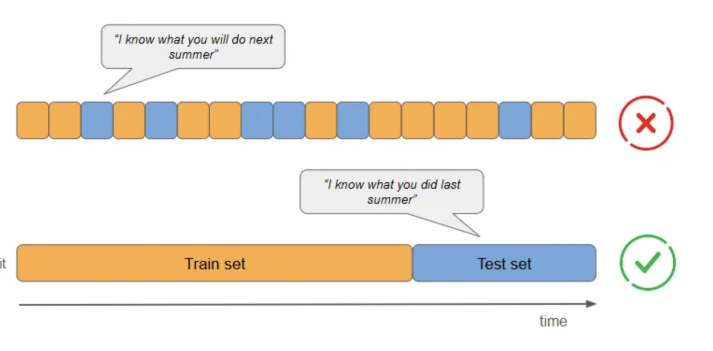
Data splitting
Initially you taste your food its not nice, but you keep changing things like adding spices or more salt and eventually you taste it more and change things and you like it
Learning from recent patterns and predicting what happens next
Each fold slides along time as the model is trained
Notes:
I used 50 folds so I split the data into 50 chunks. Each fold uses a new chunk of data to test how well the model generalises .With time series, we can't just mix and match data randomly because order matters. So, we use rolling window validation — like sliding a window through time.

Slide 17

Training model
To train the model, we use a powerful ‘chef’ (XGBoost) who learns from the data how different factors affect energy use.
Time series data remembers the past.
Randomly shuffling it for train-test splits? Please, don’t!
Notes:
XGBoost — who studies the recipe (the data) and learns how different ingredients (features) like past energy use, temperature, and patterns over time affect energy consumption.

Slide 18
Training model
Dataset | In cooking terms | In pipeline
Train | Daily cooking practice (Jan–Aug) | Model learns from past data
Validate | Recipe tuning (Sept–Oct) | Adjust hyperparameters on recent past
Test | Final competition (Nov–Dec) | Evaluate model on truly unseen data
Notes:
Training data teaches the model.
Validation data checks how well it’s learning during training.
Test data is the final exam — it tells us how the model performs on unseen data.

Slide 19
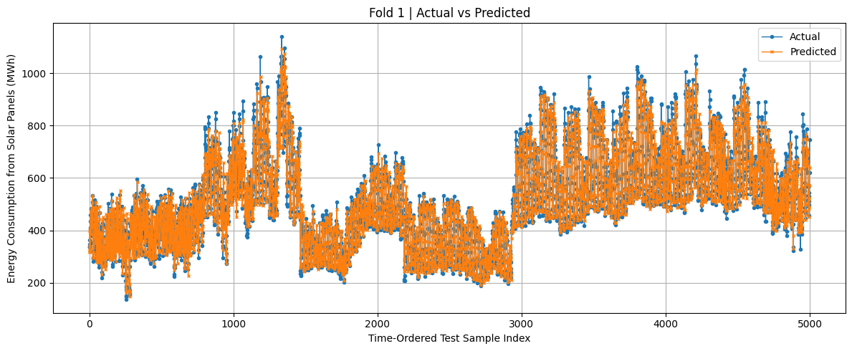
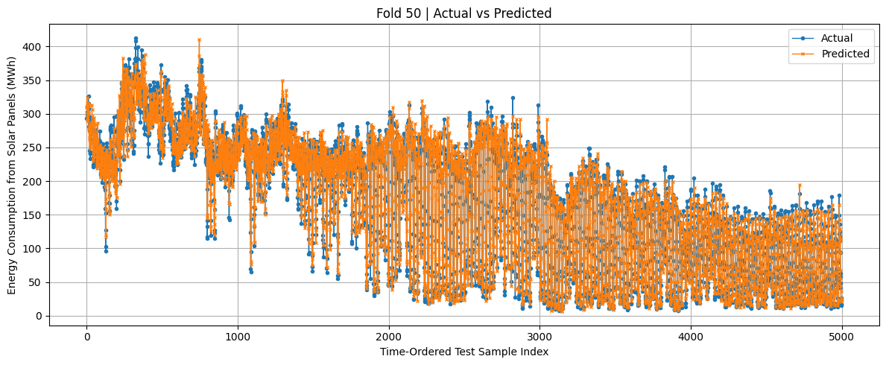
Evaluation
Train RMSE: 123.6001
Val RMSE: 108.7727
Test RMSE: 47.0837
Train RMSE: 39.6588
Val RMSE: 8.9938
Test RMSE: 18.8226
Train RMSE: 123.6001, Val RMSE: 108.7727, Test RMSE: 47.0837
Train RMSE: 39.6588, Val RMSE: 8.9938, Test RMSE: 18.8226
Train RMSE: 39.6588, Val RMSE: 8.9938, Test RMSE: 18.8226
Notes:
As you can see in fold 1, the data has a much higher error than fold 50. This clearly shows that as the model sees more recent and relevant data through rolling window validation, it learns patterns better, and its performance improves significantly. In time series modelling, respecting the timeline isn't just best practice — it's essential. Our results prove that with the right data, thoughtful features, and time-aware validation, model performance becomes more reliable and more realistic.

Slide 20
What am I leaving with?
Hands-on with Infrastructure as Code (Terraform)
Improved data SCIENCE & ML
skills
Working in a professional team environment at Centrica

